Slide 1
Hair Catalog
A Collection Assessment

Slide 2
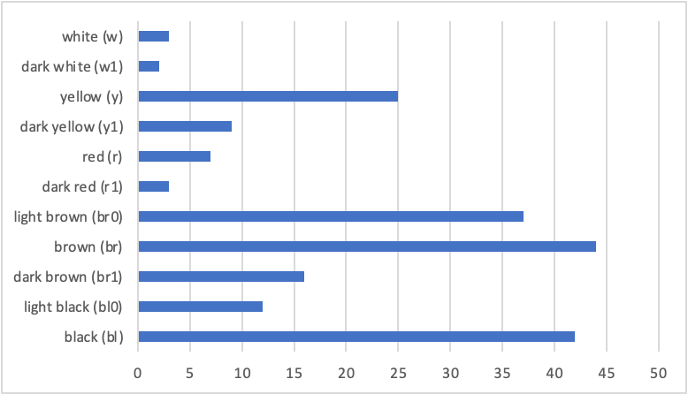
Total Number of Hairs by Color

Slide 3
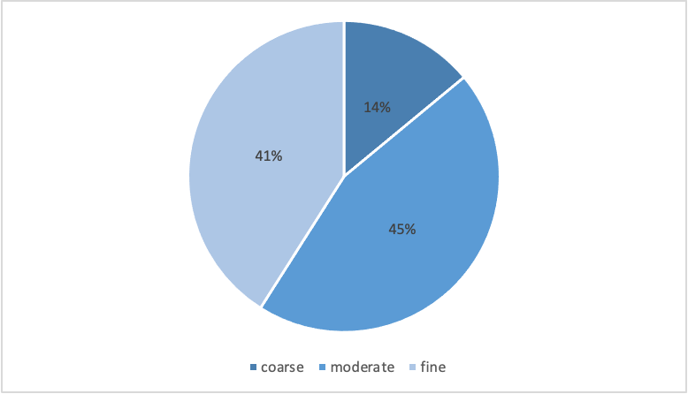
Total Number of Hairs by Thickness

Slide 4
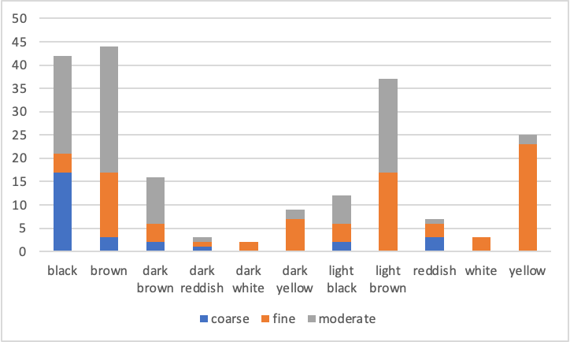
Thickness by Hair Color

Slide 5
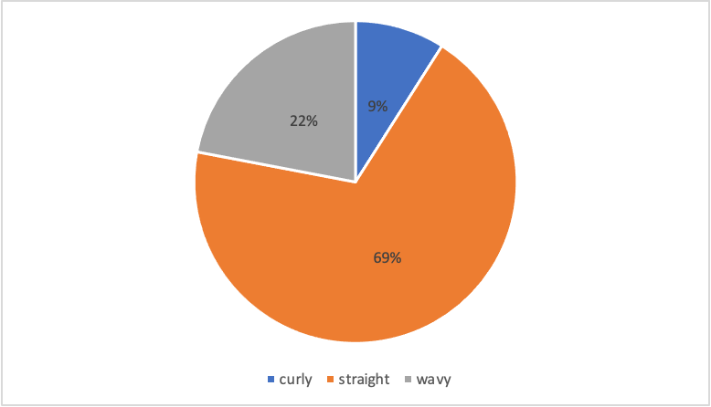
Total Number of Hairs by General Form

Slide 6
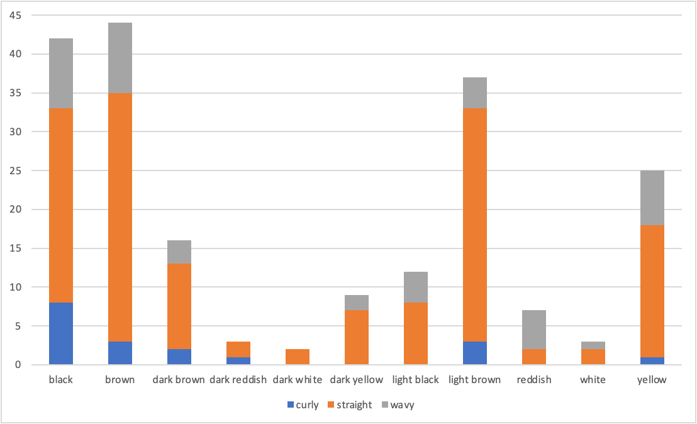
General Form by Hair Color

Slide 7
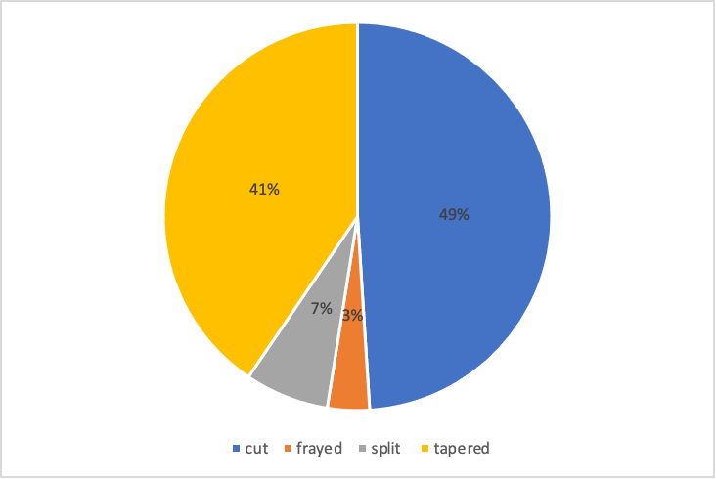
Total Number of Hairs by Tip

Slide 8
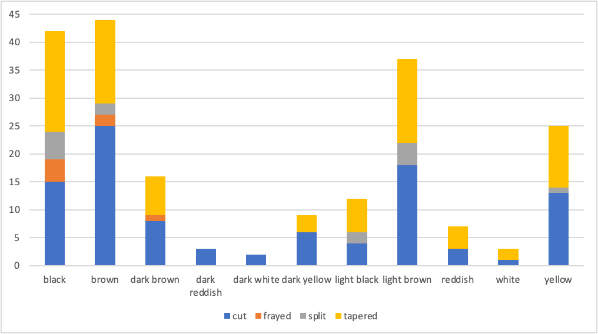
Tip by Hair Color

Slide 9
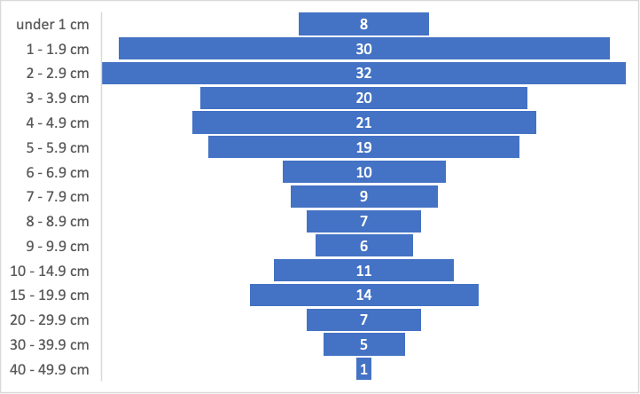
Total Number of Hairs by Length

Slide 10
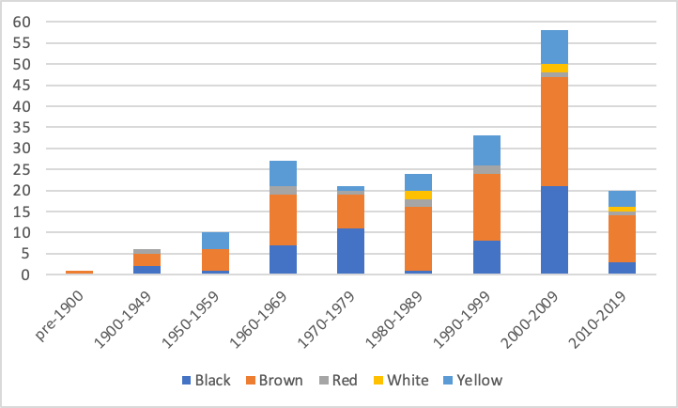
Publication Date by Hair Color

Slide 11
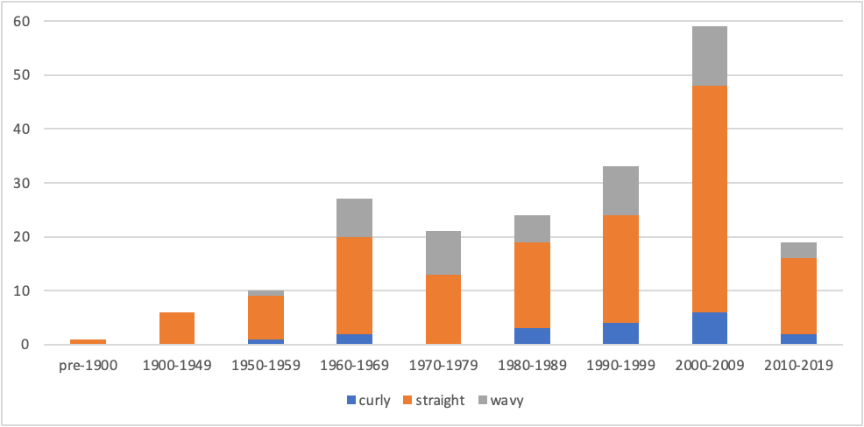
Publication Date by General Form

Slide 12
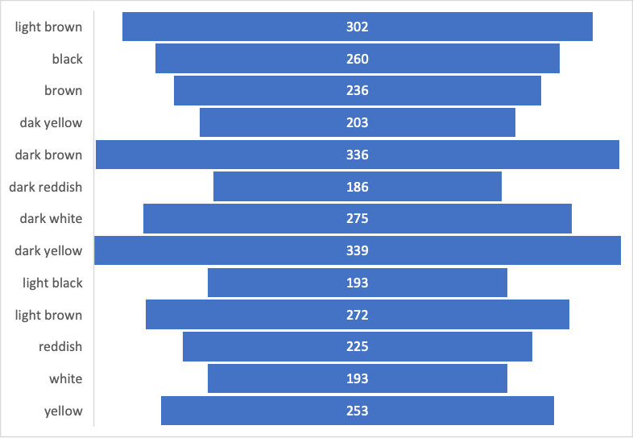
Average Number of Pages by Hair Color

Slide 13
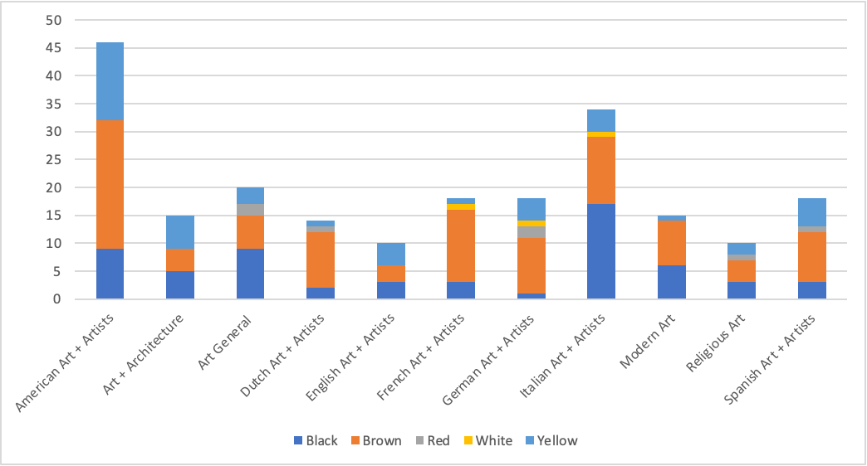
Top Subjects by Hair Color

Slide 14
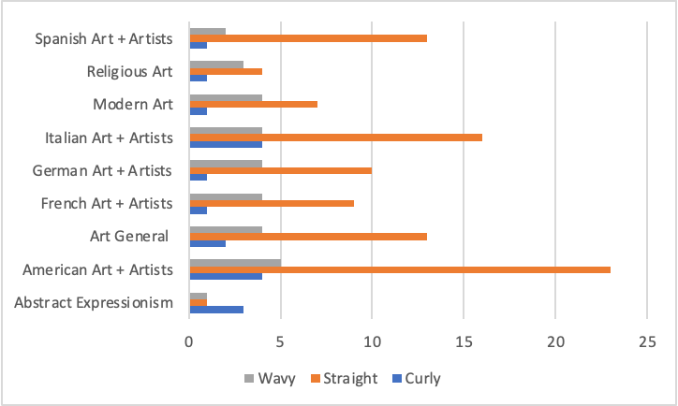
Subjects Used by All General Forms

